Slide 1
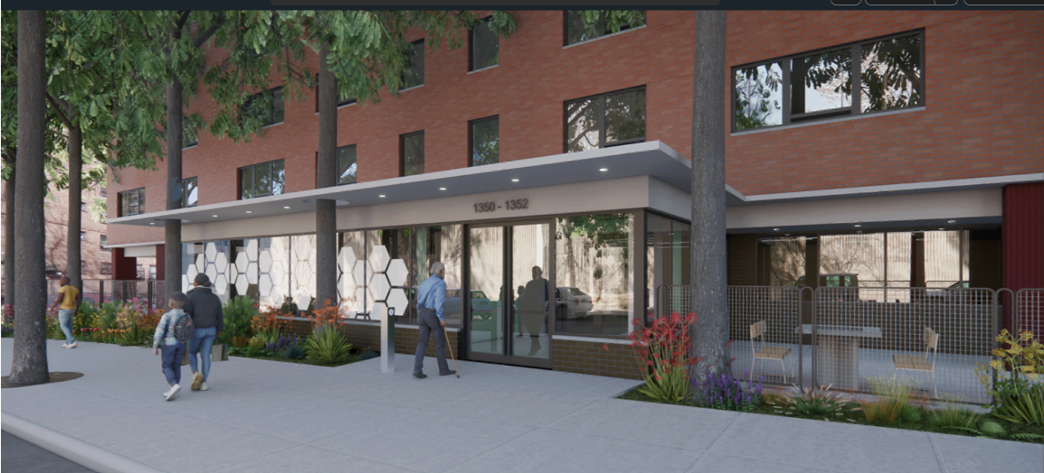

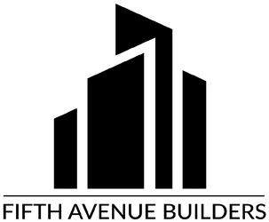
BRONX RIVER ADDITION
MEET THE
DESIGN BUILD TEAM
FIFTH AVENUE BUILDERS (FAB)
Credit: CTA Architects P.C.
Rendering subject to SHPO and NPS approval

Slide 2

Agenda
01
Introduction
Welcome & Recap from The Trust
Meet TEAM FAB (Fifth Avenue Builders)
Work Scope
Timeline
Resident Engagement, Communication & Support
Next Steps
Questions & Answers

Slide 3
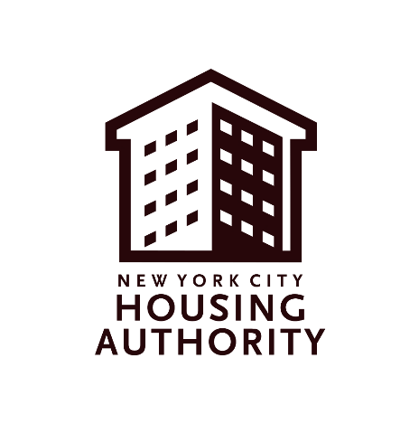


The Trust is a Public-Public Partnership
GOVERNMENT AGENCY
GOVERNMENT AGENCY
NYCHA retains ownership of the land and buildings.
NYCHA continues to manage the property.
NYCHA remains responsible for managing tenancy issues.
The Trust will lease both the land and buildings.
The Trust will comprehensively repair, renovate, modernize, and improve operations of the public housing developments that have voted to join.
The Trust will ensure your development will continue to receive sufficient funding to keep its buildings in a state of good repair after renovations.
Properties will continue to be publicly owned and managed by NYCHA, and the workforce will remain public.
Notes:
Vlada

Slide 4
Quick refresher: Trust, PACT, and Section 9
The Trust
(NYC Public Housing Preservation Trust)
PACT
(Permanent Affordability Commitment Together)
Section 9
Federal funding: | Project Based Section 8 | Project Based Section 8 | Section 9
Baseline Renovations: | Comprehensive renovations | Comprehensive renovations | Limited repairs
Management: | NYCHA staff | Private and non-profit partner(s), incl. social service providers | NYCHA staff
Resident Rights & Protections: | Preserved | Preserved | Continued
Rent: | 30% of Income | 30% of Income | 30% of Income
Land & building ownership: | NYCHA (but ground leased to the Trust) | NYCHA (but ground leased to a third-party private or non-profit developer) | NYCHA
Notes:
Vlada

Slide 5
The Trust retains the resident rights that you currently have under Section 9
Rent will be 30% of adjusted gross household income.
Your family will have succession rights.
You will have the right to renew your lease so long as you want to continue living here – and leases can only be terminated for good cause.
You will not be re-screened upon conversion.
You will be able to add family members to your lease.
Your existing utility payments will remain unchanged – if you don’t pay now, you won’t pay after.
You will be able to have grievance hearings.
You will be able to access in-person assistance at the development as well as phone and online assistance with your paperwork.
Resident services continues to assist residents in accessing social services.
You will have the right to organize a resident association, which will continue to receive funding.
Notes:
Vlada
If Q&A about transfers arises: After one year following conversion to the Project-Based Section 8 program, an income-qualified family can request a Tenant-Based Section 8 Transfer Voucher and move within the five boroughs or even out of New York. In a situation that qualifies as an emergency, the one-year transfer rule can be waived. The voucher program allows tenants to move anywhere in the United States where Section 8 vouchers are accepted.

Slide 6
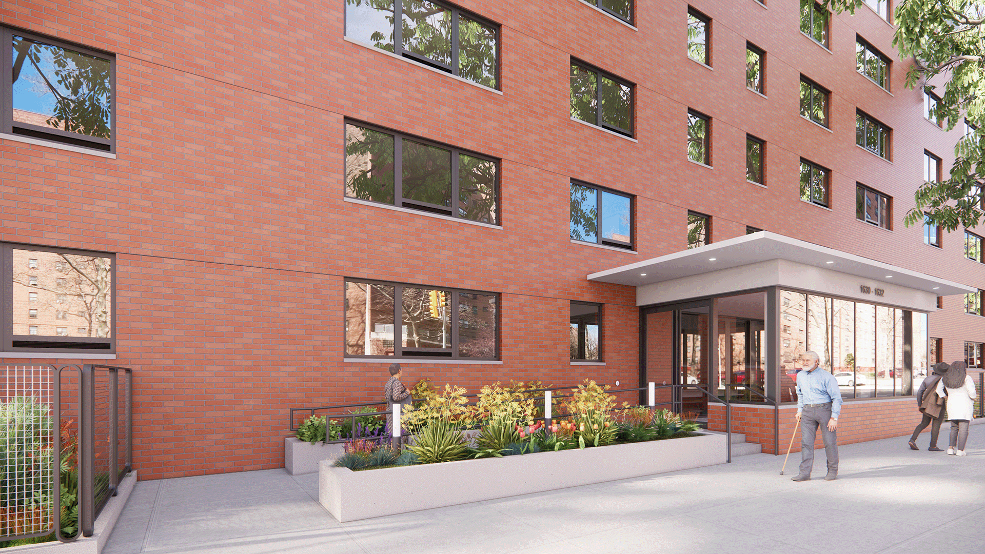

MODERNIZATION AND PRESERVATION PROGRAM at
BRONX RIVER ADDITION
FIFTH AVENUE BUILDERS
COMMUNITY MEETINGS
REMOTE on ZOOM
Wed. (Nov. 5) 5:00 PM English
6:00 PM Spanish
IN PERSON Bronx River Community Center
Thurs. (Nov. 6) 11:00 to 12:30 English
12:30 to 2:00 Spanish
Credit: CTA Architects P.C.
Rendering subject to SHPO and NPS approval

Slide 7

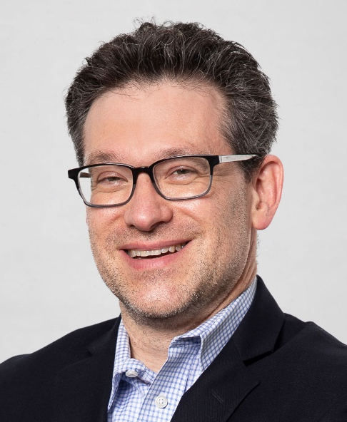


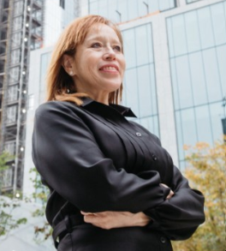
FIFTH AVENUE BUILDERS (FAB)
A team of established affordable housing professionals with the shared core value that resident involvement is foundational to successful projects.
GREG
ETIENNE
Co-Lead
Fifth
Avenue
Builders
BEN
KORNFEIND
Co-Lead
Fifth
Avenue
Builders
CHRISTA
WARING
Lead
Architect
CTA
CAITLIN
COLEMAN
Community
Engagement
& Relocation
HOU
PATRICIA
TORO
Section 3
& Community
Support
Toro
Construction

Slide 8

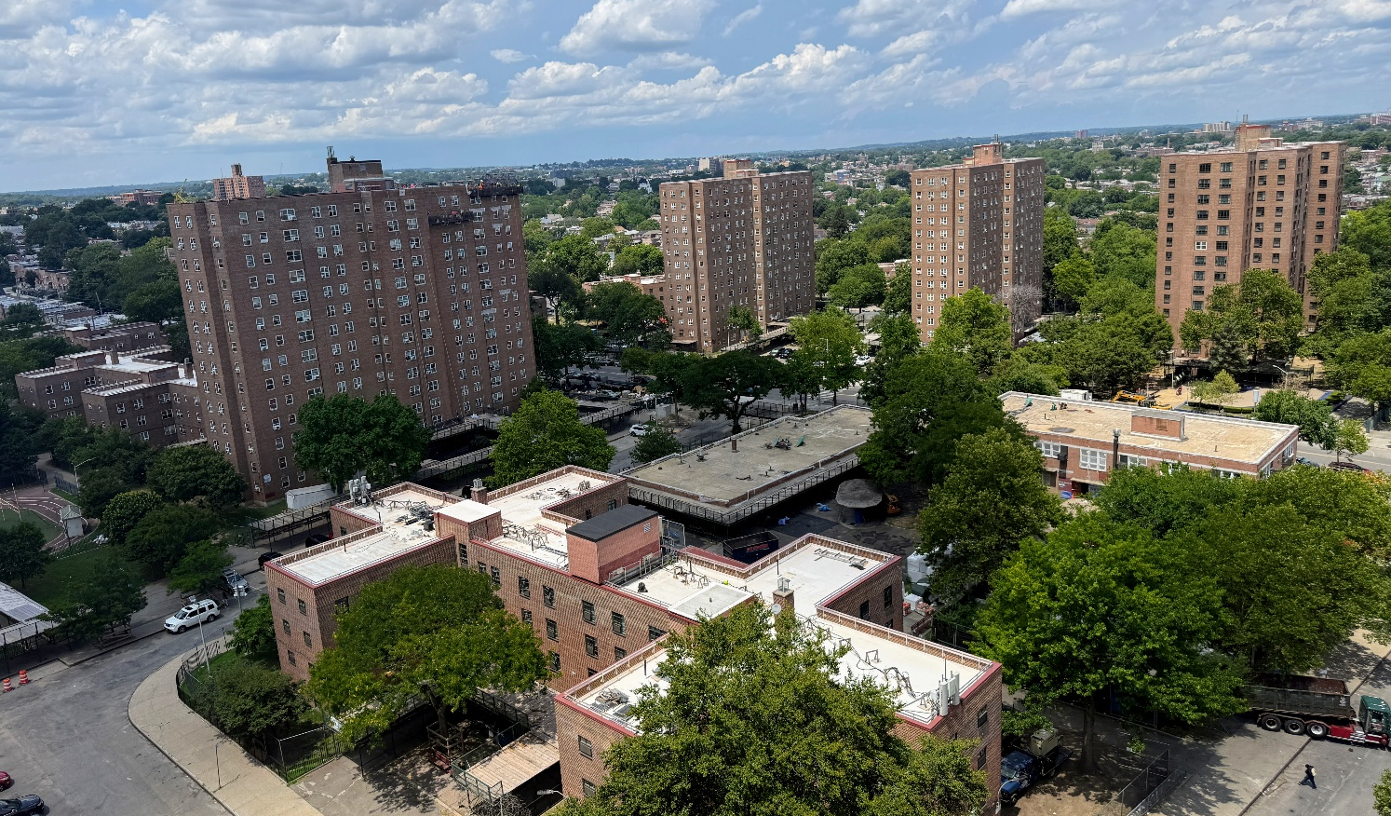
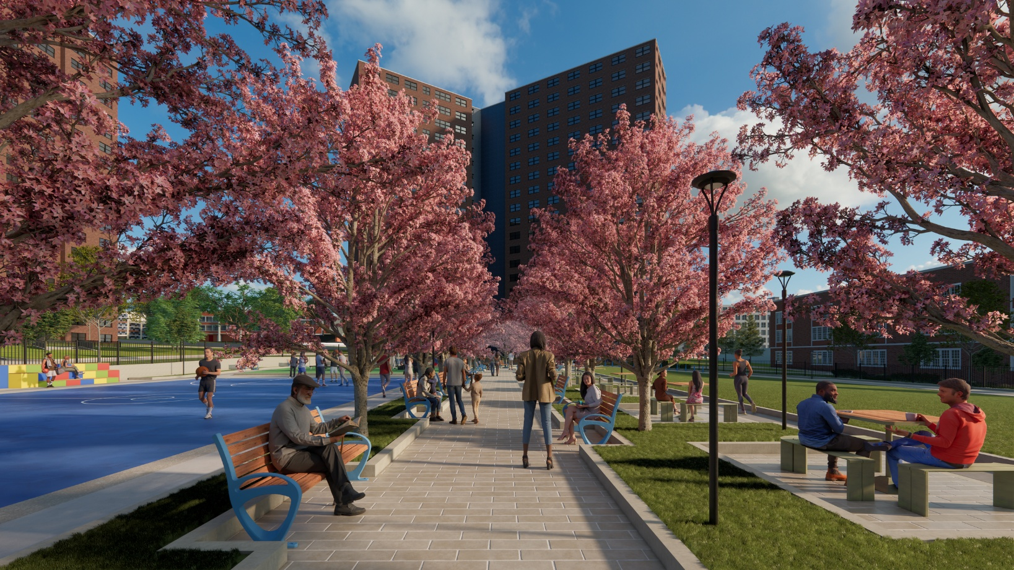




TEAM EXPERIENCE
Our team is experienced:
Over 25 years renovating & building affordable housing across NYC.
Over 40 years providing resident services, engagement and relocation work.
Over 35 years designing energy-efficient, accessible buildings, including NYCHA projects.
Over 10 years of employment outreach, support and hiring compliance monitoring.
We’ve worked at: Edenwald Houses, Roosevelt Houses, West Brighton, Fulton Elliott Chelsea Manhattanville, Park79 & WHEDCO, and Linden Plaza (1,500+ affordable rentals in Brooklyn.)

Slide 9
WORK SCOPE: MISSION STATEMENT
01
Introduction
LIVABILITY and ACCESSIBILITY inspired our proposed design:
You deserve a clean, safe, and comfortable environment where you can live healthily, independently, and enjoy your family, neighbors, and local community.
Your home should be as accessible to you as much as possible. You should be able to cook, bathe, relax, and be an honored member of your community.

Slide 10
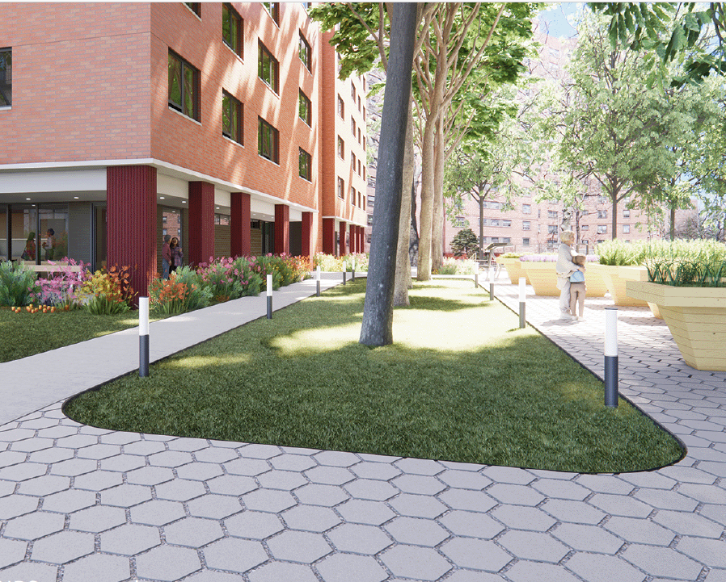
WORK SCOPE: EXTERIOR
All design supports senior living
Maximize accessibility indoors and outdoors, including repairing or adding ramps to entrances.
Outdoor space with garden, exercise equipment, porch seating, benches, and game tables
Parking lots will be resurfaced
Rendering subject to SHPO and NPS approval
Credit: CTA Architects P.C.

Slide 11
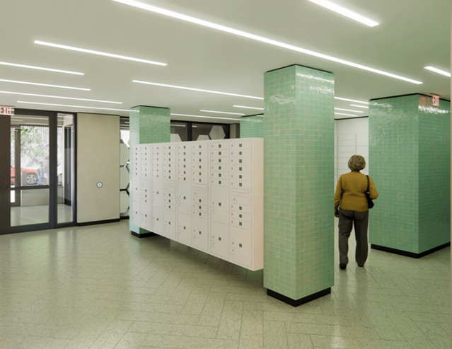
WORK SCOPE: COMMON AREAS
01
Introduction
Improved security to keep you and your guests safe:
New entry doors & hardware
New intercom
New key fob systems
New camera system
New community rooms, laundry rooms, and social service offices.
New chute hopper doors and recycling room at 1350 Manor Ave.
Rendering subject to SHPO and NPS approval
Credit: CTA Architects P.C.

Slide 12


WORK SCOPE: APARTMENTS
To fix all the problems, we need to get behind your walls…
Abate lead, eliminate mold, and remediate asbestos when found.
Replace all plumbing and fix root causes
Replace all elevator components in each building for reliable service, with proper upkeep
Pest sealing
New individually controlled heating and cooling units
New awning windows easily open and close
Credit: CTA Architects P.C.
Rendering subject to SHPO and NPS approval

Slide 13
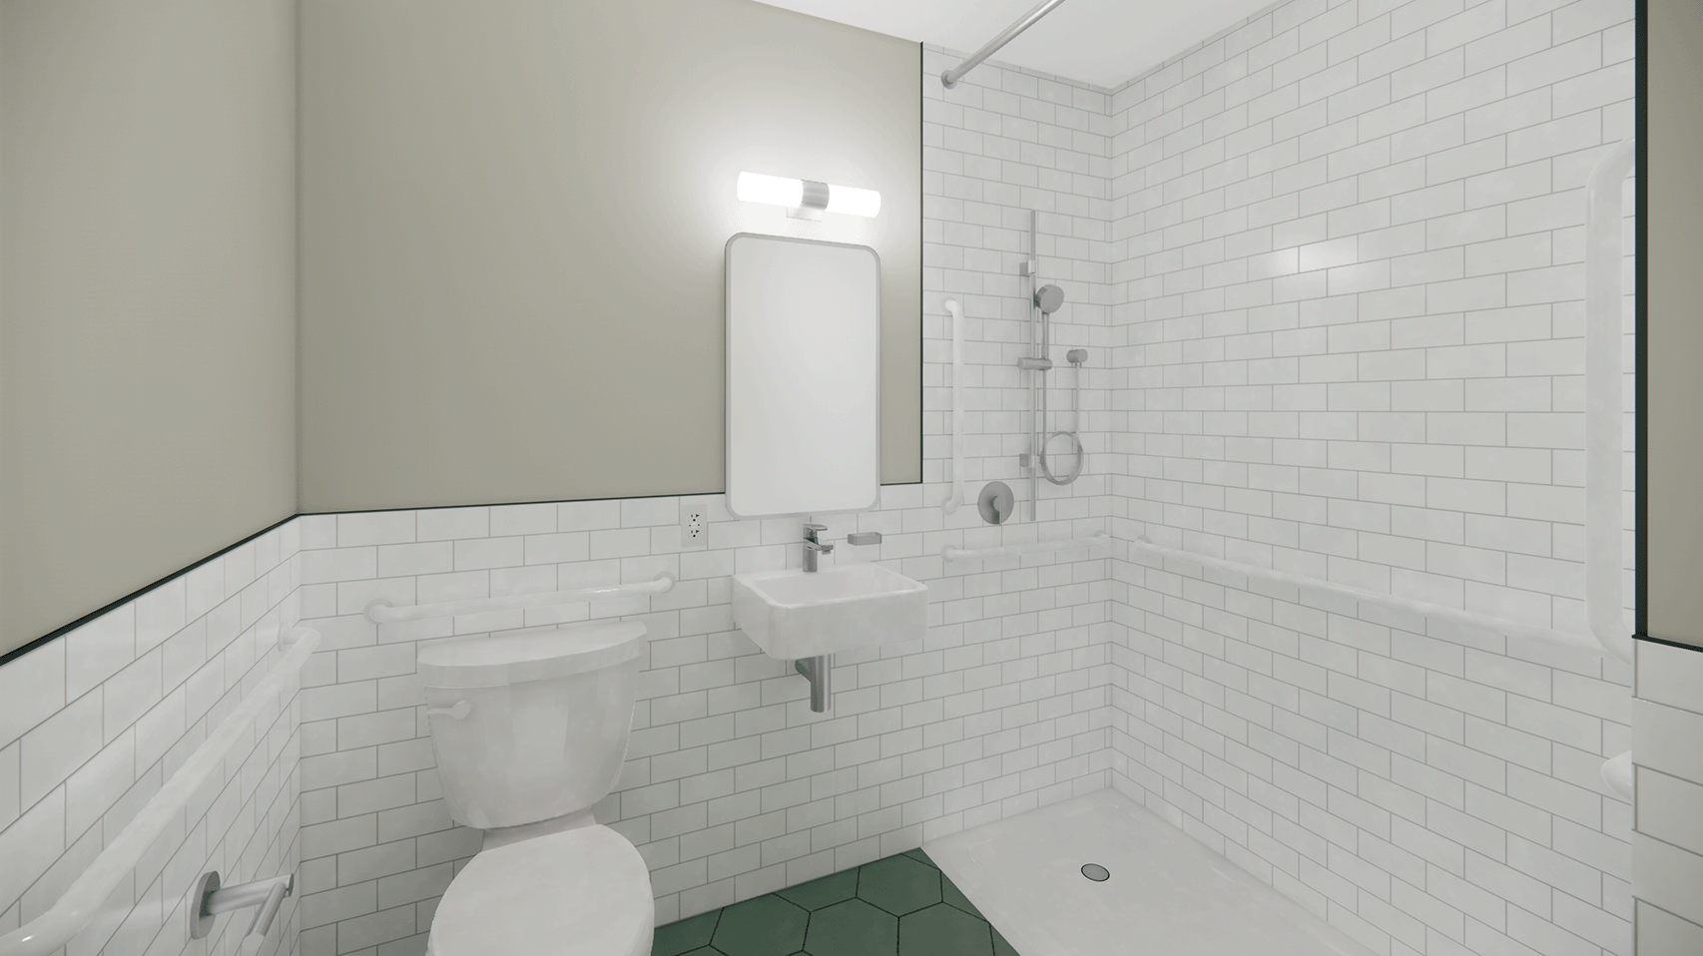
WORK SCOPE: BATHROOMS
01
Introduction
Grab bars
New lighting and walls/floors
Removable Vanities
Roll-in and Step-in showers
New lighting and plumbing fixtures
Residents will help choose finishes
Credit: CTA Architects P.C.
Rendering subject to SHPO and NPS approval

Slide 14
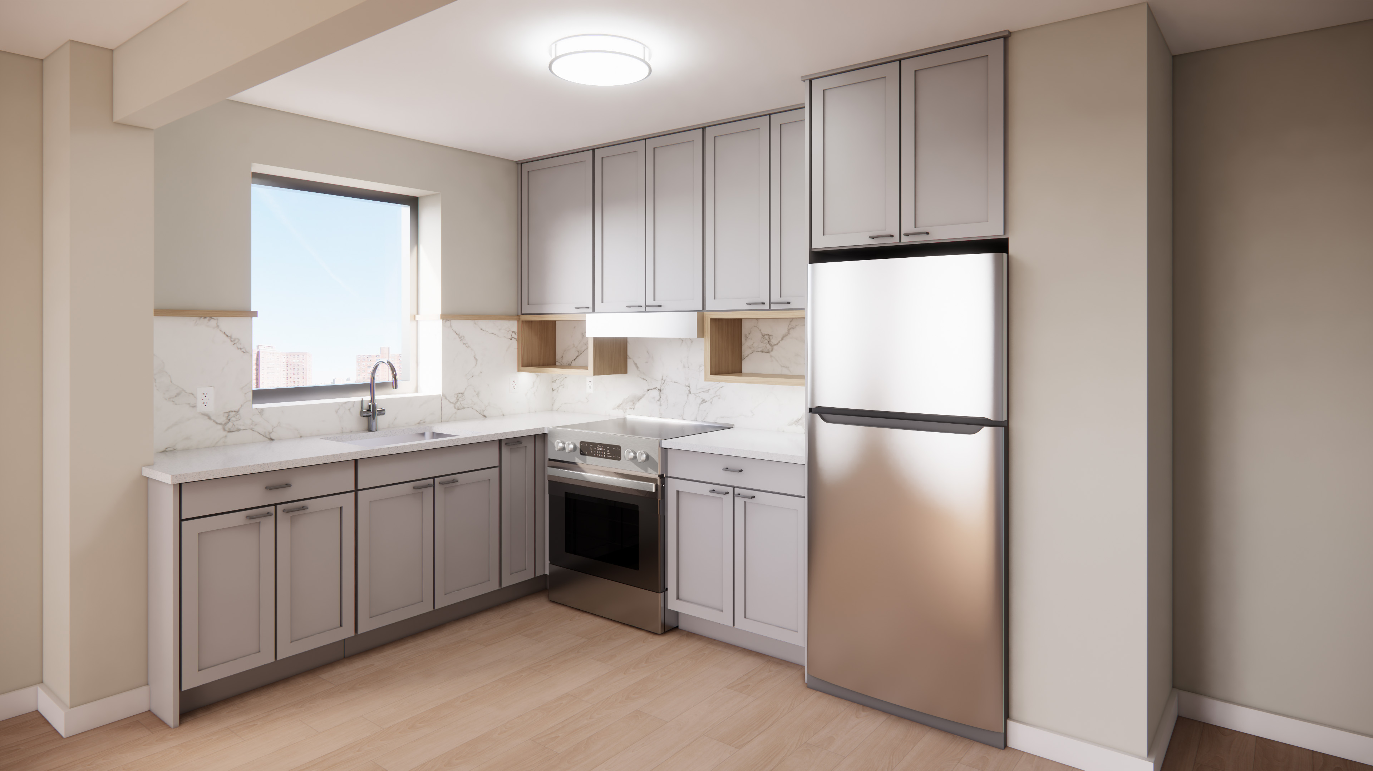
WORK SCOPE: KITCHENS
01
Introduction
New stoves and refrigerators
New cabinets, backsplash, and countertops
More workspace
Hookup for a washing machine
New lighting and plumbing fixtures
Residents will help choose finishes
Credit: CTA Architects P.C.
Rendering subject to SHPO and NPS approval

Slide 15



Project / Construction Timeline
01
Introduction
CONSTRUCTION
START – B12
Fall 2026
CONSTRUCTION
START – B11
Fall/Winter 2026
COMPLETED
Fall 2027 – B12
COMPLETED
Fall/Winter 2027 – B11

Slide 16


Engagement & Relocation Timelines
01
Introduction
Community Engagement
BUILDING 11
Part-time office hours start December 2025
Full-time office hours start Spring 2026
Relocation Assessments start
Spring 2026
Relocation Starts
Fall/Winter 2026
FAB Engagement Office
1350 Manor Ave., Apartment 3J
Move-back & Lease-signing in Fall/Winter 2027

Slide 17
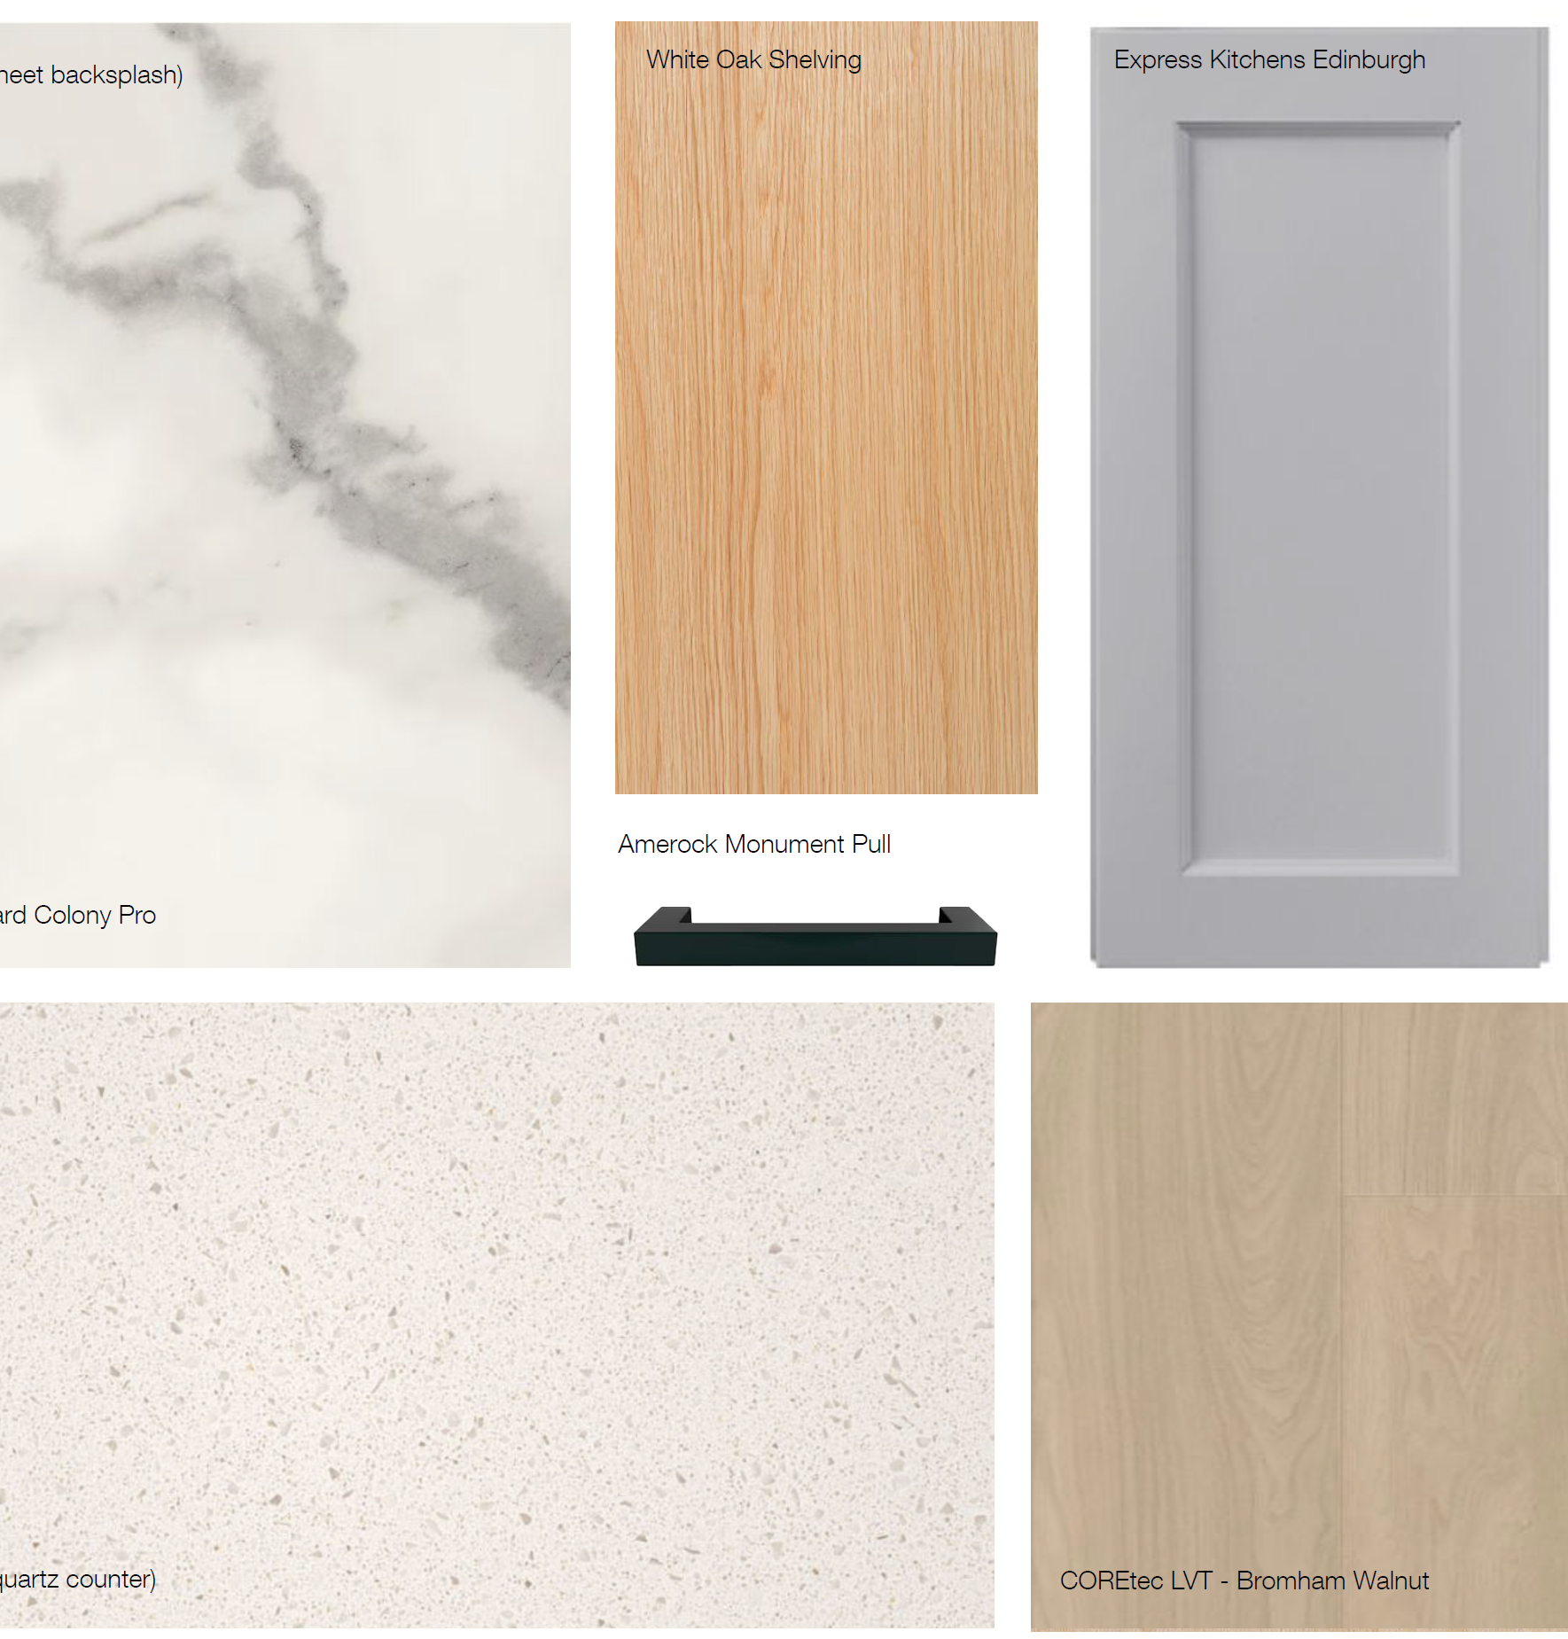
What’s Next? Early December 2025
01
Introduction
Design Finishes - One design for all apartments.
Residents will give feedback and vote on:
Kitchen and bath countertops
Backsplashes
Wall tile
Flooring, including bathroom tile
Paint colors
Cabinet finishes
Appliances
Light fixtures
You will receive notice of the dates and times in a flyer and phone call in November.
Credit: CTA Architects P.C.
Rendering subject to SHPO and NPS approval

Slide 18
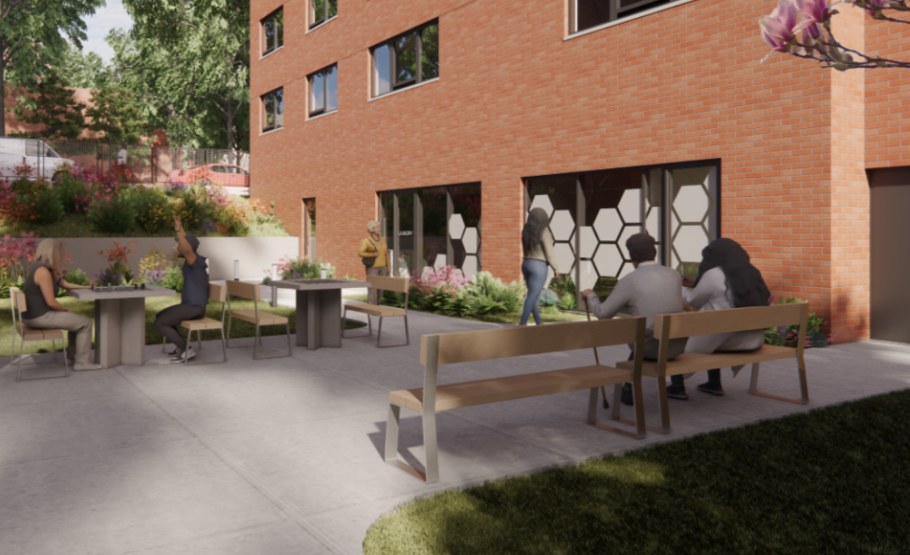
What’s Next? Early 2026
Resident Support Individualized Case Management
01
Introduction
We will start community informational meetings about relocation, temporary NYCHA apartment options, and how the engagement team will work with you to create individualized moving plans.
Credit: CTA Architects P.C.
Rendering subject to SHPO and NPS approval

Slide 19

Question and Answer Session
01
Introduction

